Slide 2
Digraphs and Relations
Directed graphs
Adjacency
Out-degree and In-degree
Directed Paths and Directed Cycles

Slide 3
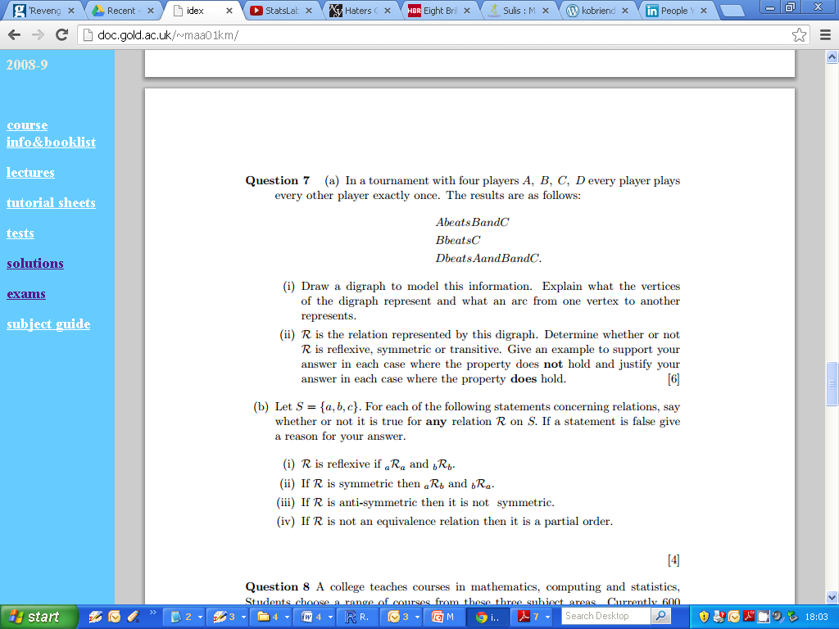
Tournament Example : Digraph

Slide 4
Tournament Example : Digraph

Slide 5
Relations
A relation R on set S is a rule which compares any two elements (x and y) of S and tell us whether or not x and y are related.
Notation: xRy : x is related to y under relation R

Slide 6
Equivalence Relations
Let R be a relation defined on a set S.
R is reflexive : If for all x ∈ S, we have xRx

Slide 7
Equivalence Relations
Let R be a relation defined on a set S.
R is symmetric : If for all x,y ∈ S, such that if we have xRy, we have yRx.

Slide 8
Equivalence Relations
Let R be a relation defined on a set S.
R is transitive : If for all x,y,z ∈ S, we have xRy and yRz, we have xRz.

Slide 9
Tournament Example

Slide 10
Tournament Example
Reflexive
Symmetric
Transitive

Slide 11
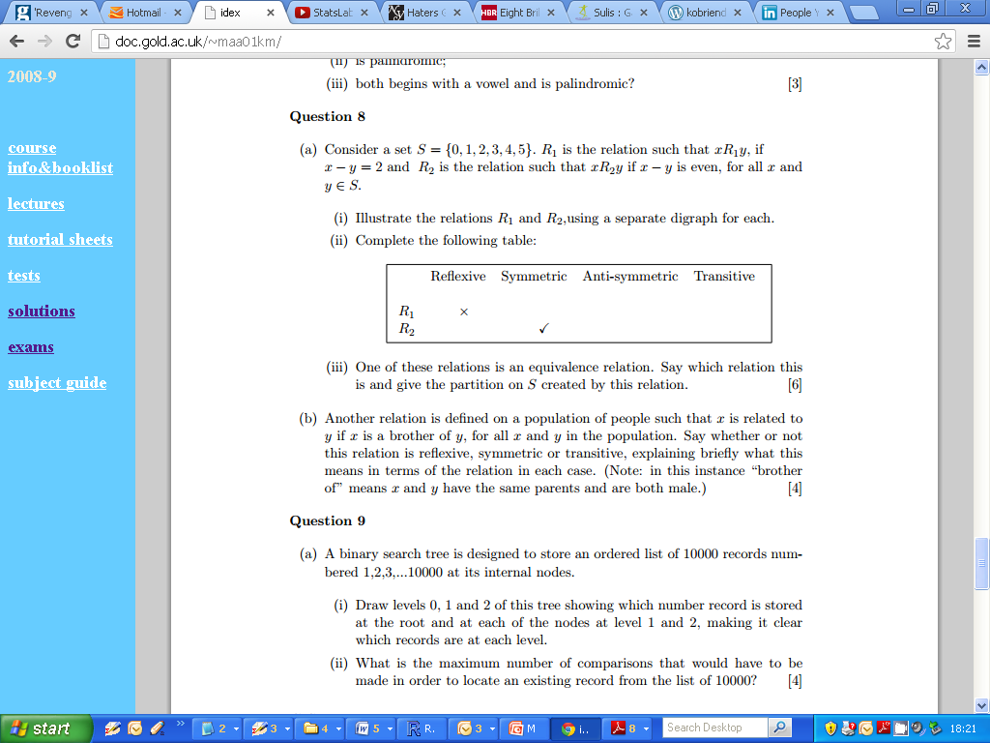
Second Example

Slide 12
Second Example

Slide 13
Second Example

Slide 14

Second Example

Slide 15
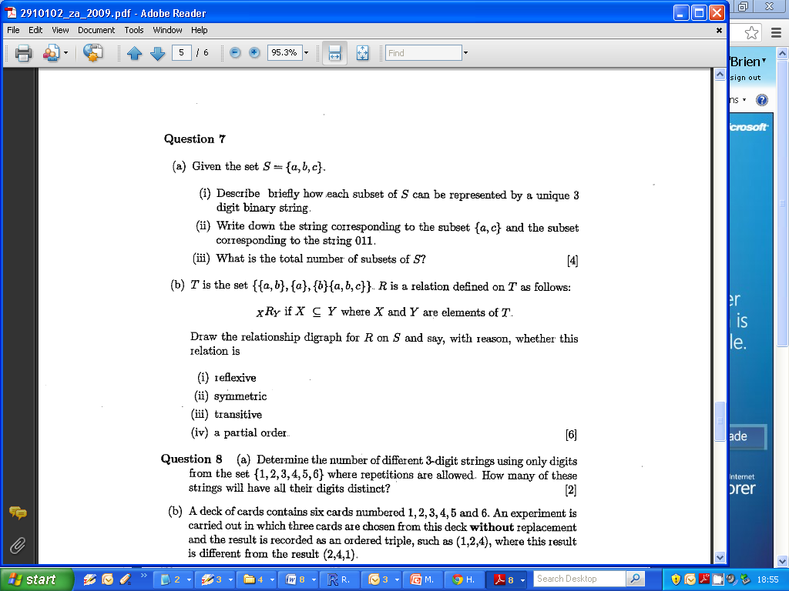
2009 Zone A Q7b

Slide 16
2009 Zone A Q7b
(Digraphs)

Slide 17
2009 Zone A Q7b
Anti-Symmetric and Partial Orders
Anti-symmetric: xRy and yRx implies that x=y
Partial Order : Relation is reflexive, anti-symmetric and transitive.

Slide 18
Cartesian Products
Let X and Y be sets. Then the Cartesian product XxY is the set whose elements are all ordered paired of elements (x,y) where x ∈ X and y ∈ Y.
Suppose X = {p,q,r} and Y={a,b,c}
XxY = { (p,a),(p,b),(p,c), YxX
(q,a), (q,b),(q,c),
(r,a),(r,b),(r,c) }

Slide 19
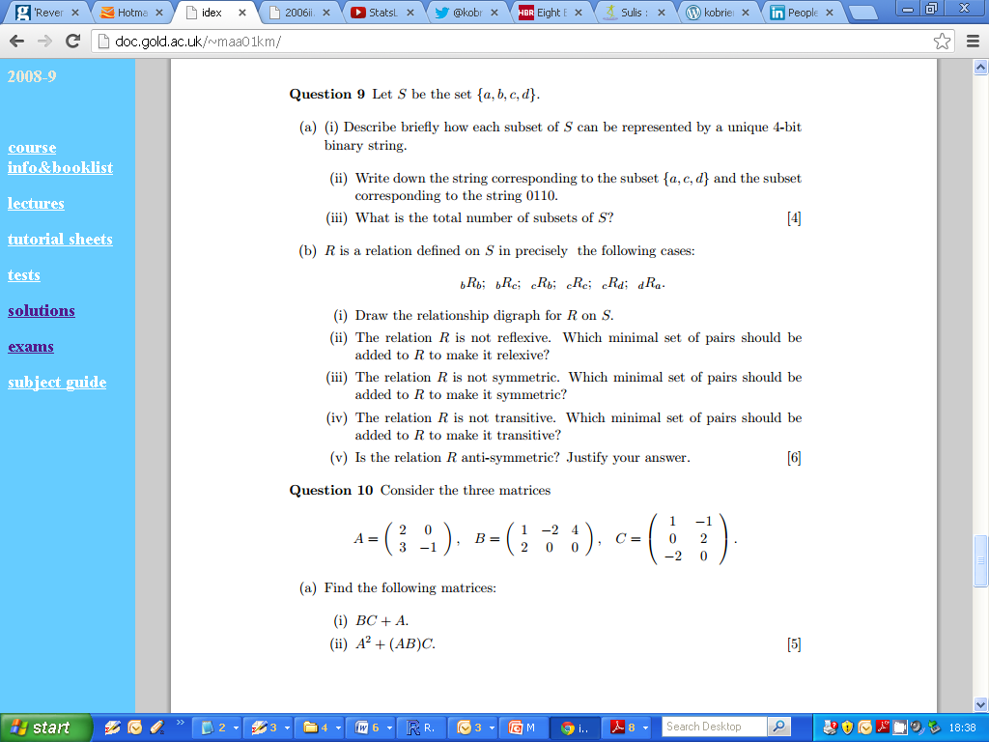
n-bit Binary Strings

